Slide 1
Chapter 06
Conducting Digital Investigations
©2011 Eoghan Casey. Published by Elsevier Inc. All rights reserved.

Slide 2
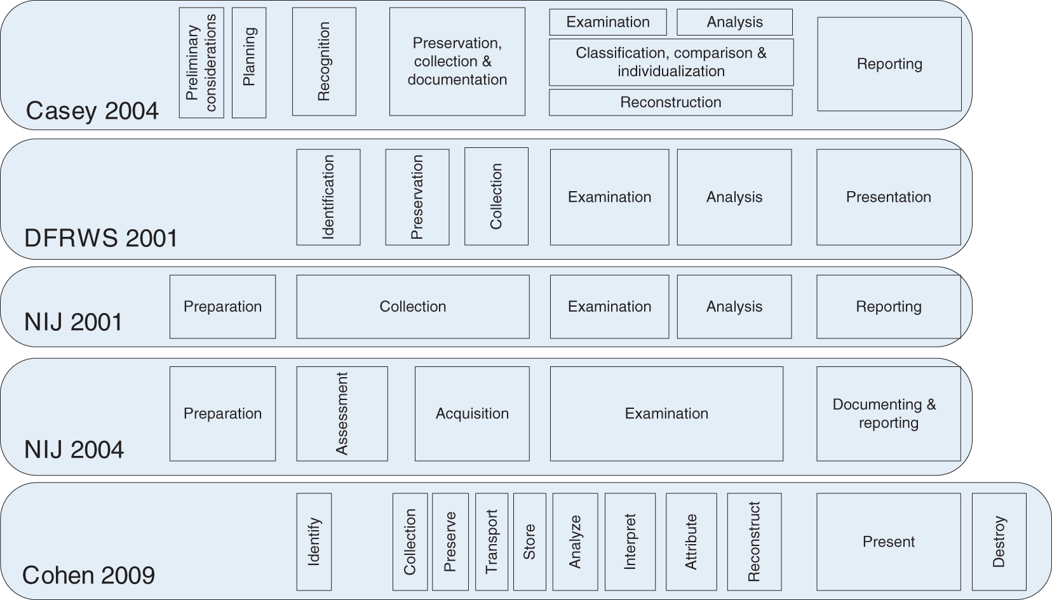
Figure 1.1
FIGURE 6.1 A comparison of terminology related to digital investigation process models.
©2011 Eoghan Casey. Published by Elsevier Inc. All rights reserved.
Copyright © 2011 Academic Press Inc.

Slide 3
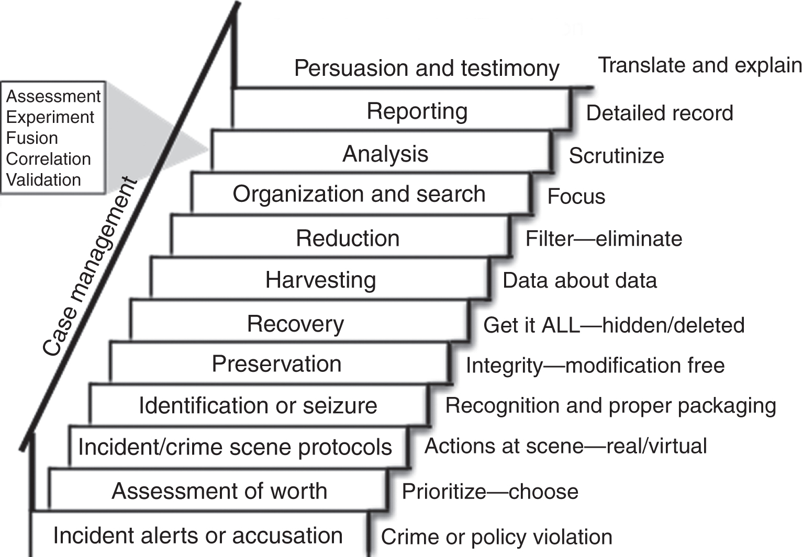
Figure 1.1
FIGURE 6.2 Categories of the investigative process model (depicted as a flight of stairs) from Digital Evidence and Computer Crime, 2nd edition.
©2011 Eoghan Casey. Published by Elsevier Inc. All rights reserved.
Copyright © 2011 Academic Press Inc.

Slide 4
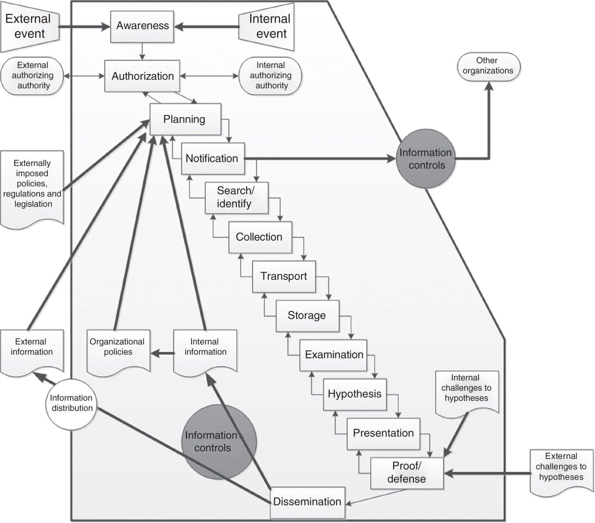
Figure 1.1
FIGURE 6.3 Ó Ciardhuáin’s extended model of cybercrime investigations.
©2011 Eoghan Casey. Published by Elsevier Inc. All rights reserved.
Copyright © 2011 Academic Press Inc.

Slide 5
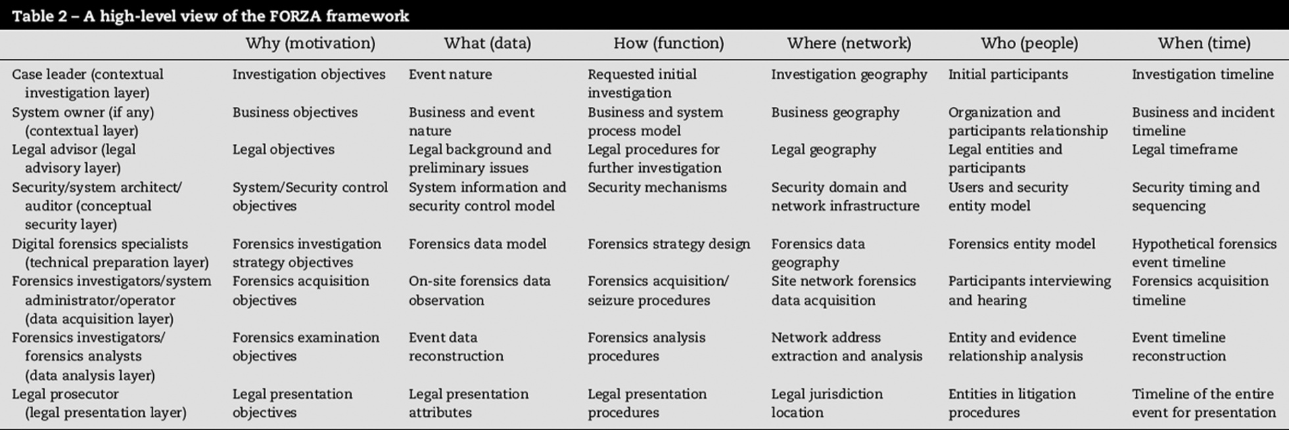
Figure 1.1
FIGURE 6.4 High-level framework for FORZA model in Ieong (2006).
©2011 Eoghan Casey. Published by Elsevier Inc. All rights reserved.
Copyright © 2011 Academic Press Inc.

